Slide 1
Nancy Wells
Vice President
Division of
Development and
Alumni Relations

Slide 2
Alumni and
Development
Facts

Slide 3
Alumni Facts
  UB has about 230,000 living alumni in 115 countries
  More than 127,000 live in
  New York State
  Regions with the highest number of UB alumni are Washington DC, Los Angeles and Florida

Slide 4
Dollars Raised
UB raised $28,762,077 last year.

Slide 5
Dollars Raised

Slide 6
How Was the Money Spent?
*Gifts for current operations restricted for specific uses that cannot be classified in one or another of the restricted categories in chart.

Slide 7
Who Are Our Donors?
Most of our donors are alumni.

Slide 8
Alumni Donors
  Of the 21,556 donors last year, 78% were UB alumni
  About 13% of alumni donors are new donors who have never given to UB before

Slide 9
Alumni Participation Rate
  UB’s alumni participation rate last year was 9.6%
  Alumni participation is a key factor in college and university rankings such as U.S. News & World Report

Slide 10
Alumni Participation Rate

Slide 11
Faculty/Staff Participation
  Faculty/staff participation rate was 11% in FY 13.
Fiscal Year | Staff Type | Total | # of Donors | % Participation Rate | Total Faculty/Staff
2013 | Faculty | $803,093 | 560 | 14.3% | 3,906
2013 | Staff | $186,324 | 473 | 8.6% | 5,507
2012 | Faculty | $985,986 | 705 | 19.3% | 3,661
2012 | Staff | $189,212 | 621 | 11.7% | 5,323

Slide 12
How Do We Compare?
Faculty/staff giving rates
FY 12
University of Virginia 24.3%
University of Oregon 23.3%
Iowa State 19.4%
Stony Brook 7.7%
University at Buffalo 7.3%*
*Percentage reflects totals compiled based upon Volunteer Support of Education standards, and do not include faculty and staff who also are alumni of the institution.

Slide 13
Faculty/Staff Participation

Slide 14
Development and
Alumni Relations
Goals and Metrics

Slide 15
Increase Faculty/Staff Giving
  Increase faculty/staff participation
  Dr. Scott Weber is involved in that effort

Slide 16
Increase Alumni Giving
  Increase alumni participation rate from 9.6% to 10%
  That is 1,000 new donors

Slide 17
Increase Alumni Participation
  Further engage alumni so they continue a life-long and positive relationship with UB
  Alumni Engagement and Philanthropy Task Force recommendations

Slide 18
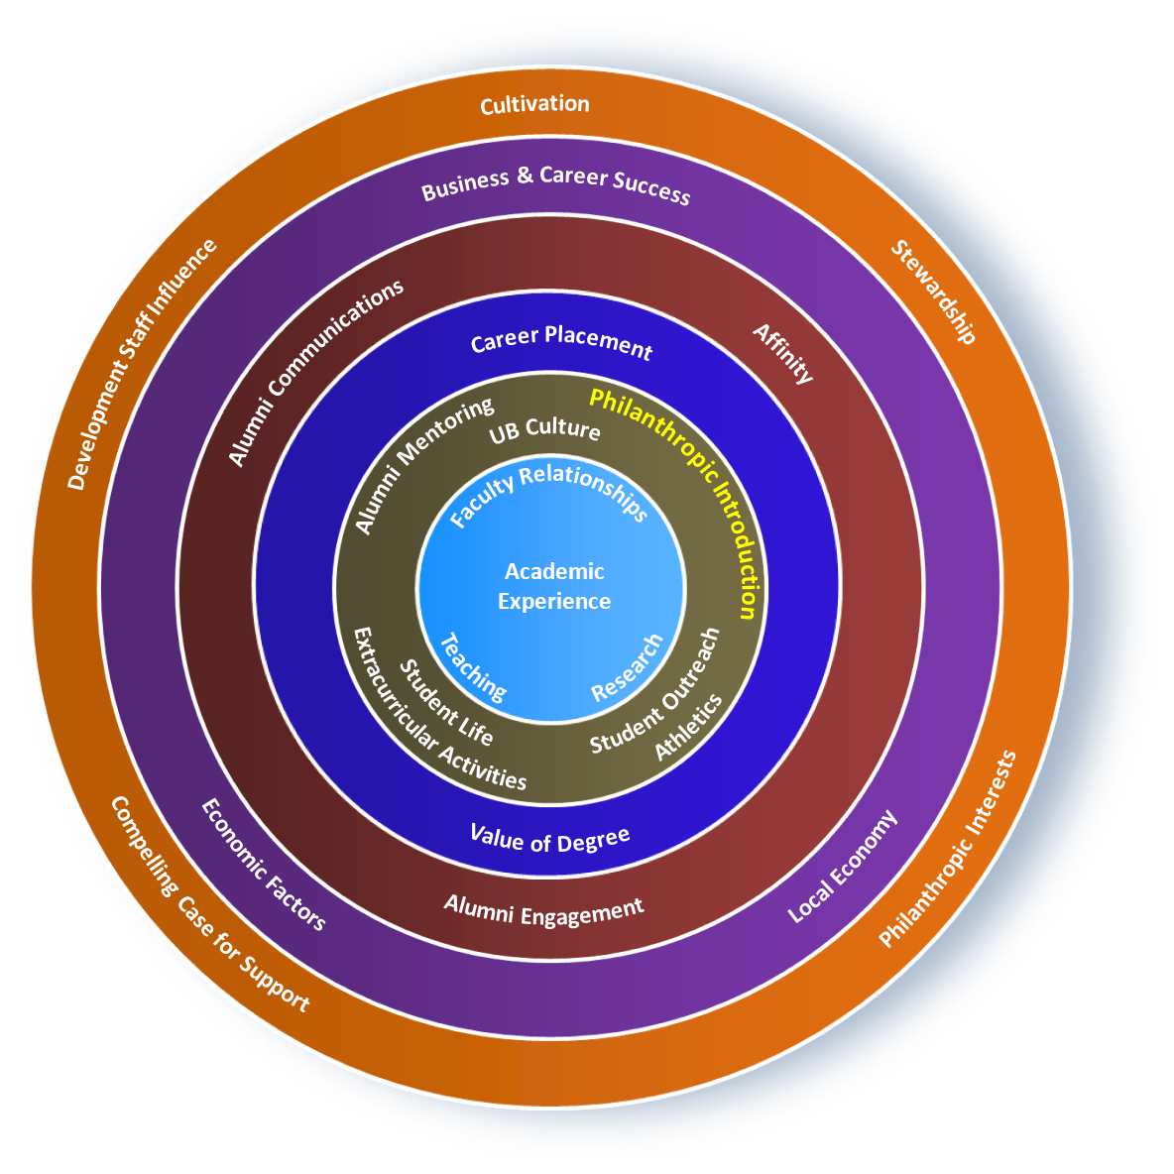
Spheres of Influence – Alumni Giving

Slide 19
Building the Culture
  Improve culture of philanthropy on campus and with constituents

Slide 20
Grow the Endowment
  UB’s endowment is $554,392,383
  UB ranks in bottom third when compared to AAU public peers

Slide 21
Why Endowment?
  The UB Foundation endowment allows UB to be less dependent upon unpredictable sources of revenue
  UBF Gift Stewardship Committee

Slide 22
Active Campaigns
  Law School
    Campaign Goal - $30M
    Total raised - $21.8M (73% of goal)
  School of Medicine and Biomedical Sciences
    Campaign Goal - $200M
    Total raised - $115.1M (57.5% of goal)
*Campaign totals through January 31, 2014

Slide 23
Key Metrics
Peer Data
Available
Gifts
X
New Pledges
Gifts for Endowment
X
Alumni Participation Rate
X
# of Tier 1 Solicitations (internal reporting only)
# of Face-to-Face Visits (internal reporting only)
Alumni Event Attendance (internal reporting only)

Slide 24
Questions & Answers
  Your Questions

